Slide 1
CLOUD COMPUTING
Team Projects
Project 1 –Serverless image processing
Project 2 –Deploy A Static Website on AWS

Slide 2
INTRODUCTION
Efficient Image Processing with Serverless Architecture on Amazon S3 allows for scalable and cost-effective image processing. With this architecture, processing times are reduced and server maintenance is eliminated.

Slide 3

AWS Lambda Function
Z
The AWS Lambda function is responsible for resizing and optimizing the images.The function is written in Node.js and uses the Sharp library to resize and optimize the images. The function is triggered when a new image is uploaded to the Amazon S3 bucket.

Slide 4
Amazon S3 is a scalable and secure object storage service. It is designed for 99.999999999% durability and 99.99% availability. Amazon S3 allows for easy integration with other AWS services, including Lambda for serverless image processing
Amazon S3

Slide 5
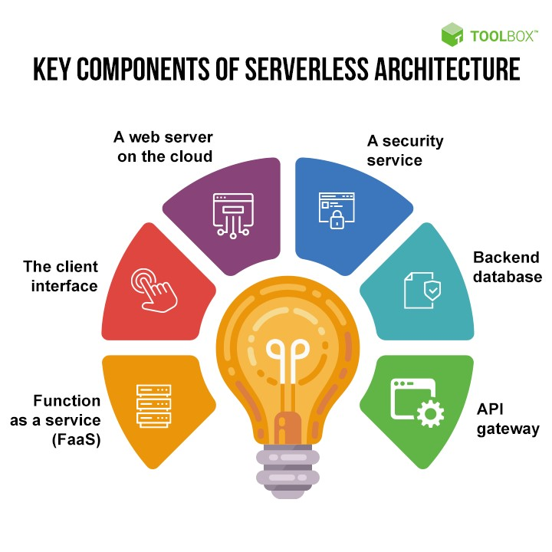
Serverless Architecture
Serverless architecture allows for automatic scaling, pay-per-use pricing, and no server maintenance. With AWS Lambda, image processing can be done on demand without the need for dedicated servers. This results in cost savings and increased efficiency

Slide 6
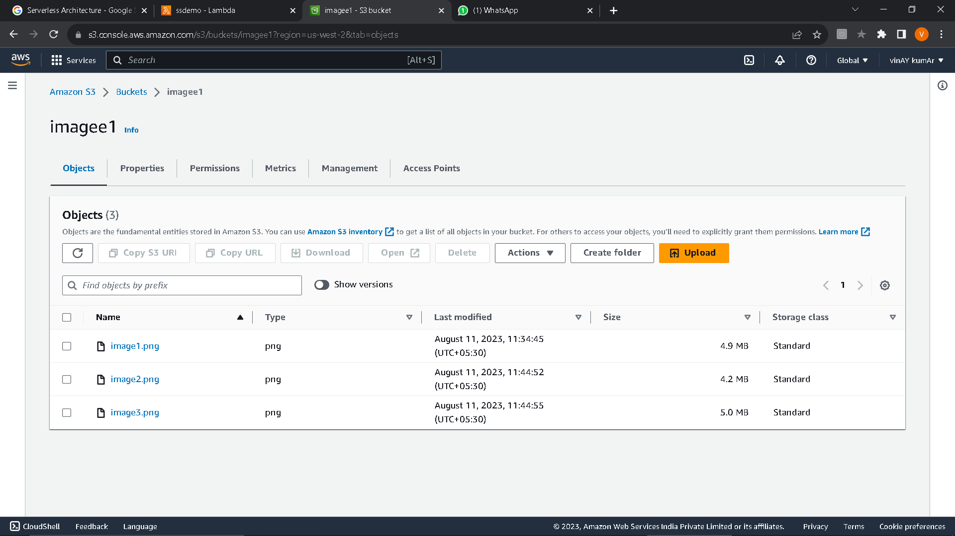
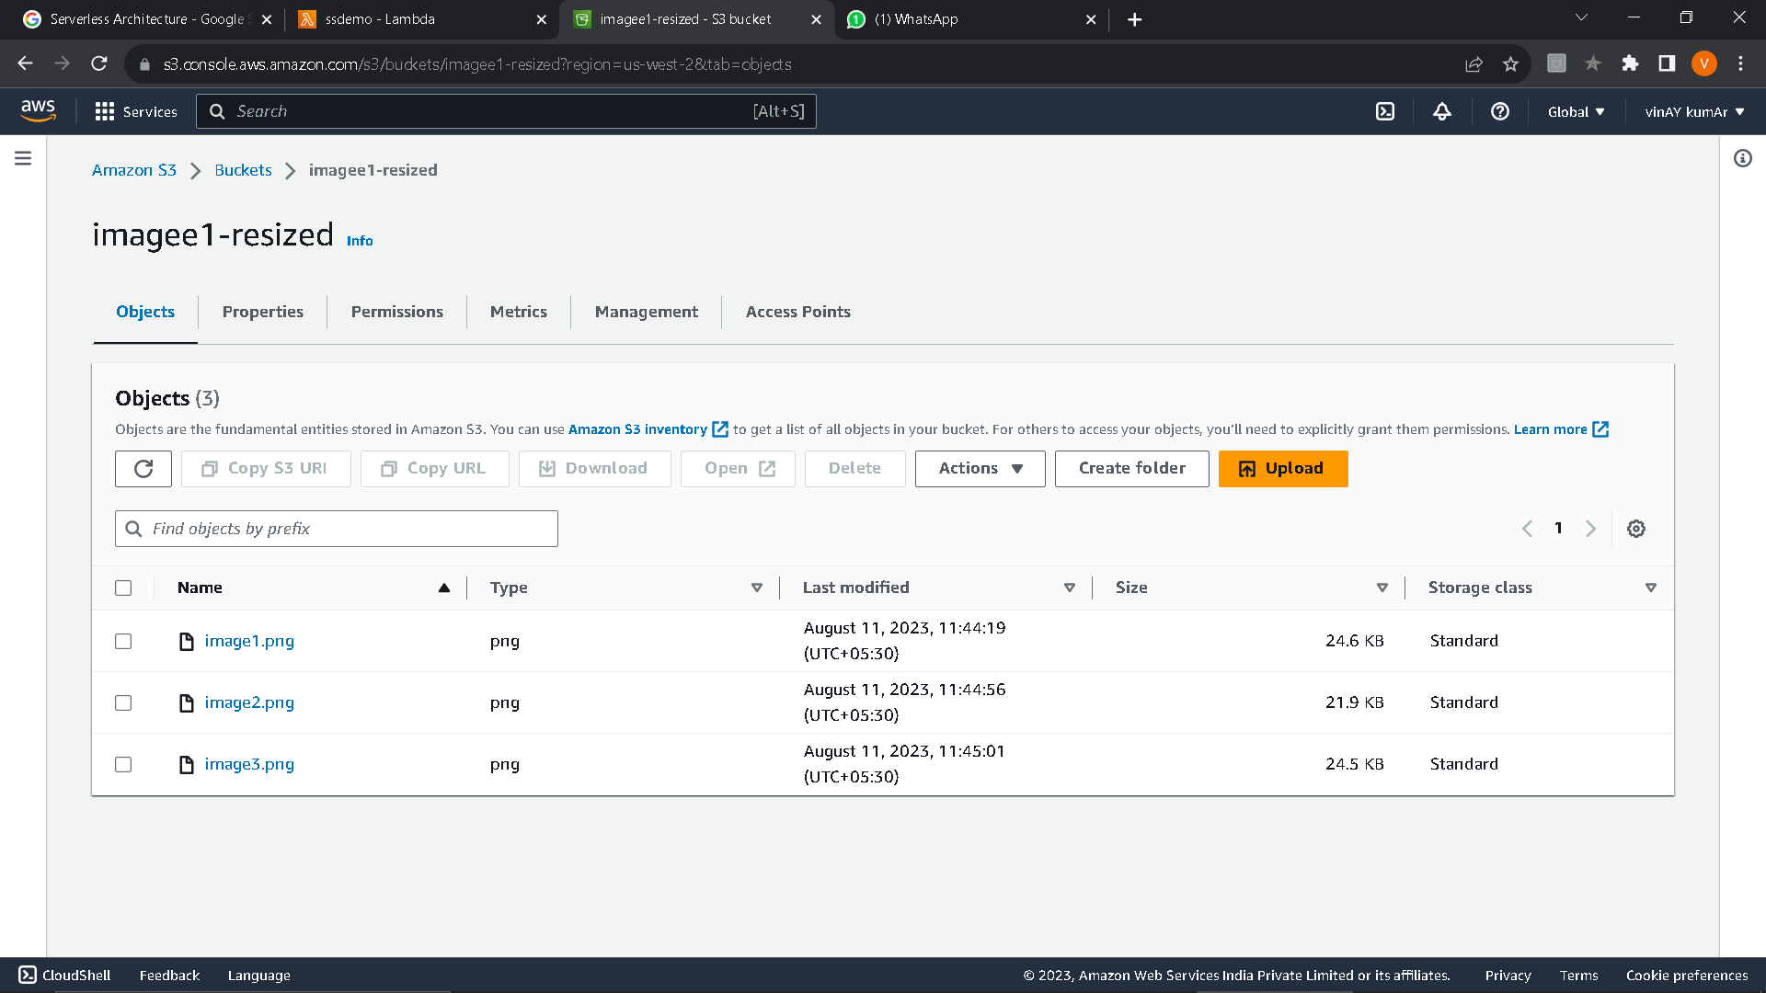
Here we can clearly see the resizing of images. images.

Slide 7
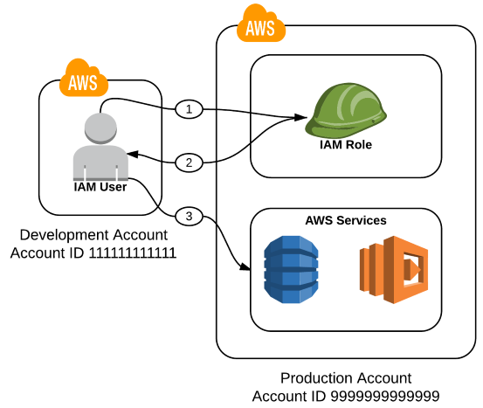
Role in AWS
A Lambda function's execution role is an AWS Identity and Access Management (IAM) role that grants the function permission to access AWS services and resources. For example, you might create an execution role that has permission to send logs to Amazon CloudWatch and upload trace data to AWS X-Ray.

Slide 8
Conclusion
Efficient image processing with serverless architecture on Amazon S3 is a scalable, costeffective, and efficient solution for image processing. By leveraging the power of AWS Lambda and Amazon S3, businesses can improve user experience, reduce costs, and increase efficiency.

Slide 9

Building a Static Website with AWS: A Step-by Step Guide

Slide 10

Introduction
A static website is a website that does not require any server-side processing. This means that the website's content is stored as static files, such as HTML, CSS, and JavaScript. When a user visits a static website, their browser loads the static files from the server and renders the website.

Slide 11

Step 1: Create an S3 Bucket
The first step to building a static website with AWS is to create an S3 bucket. This bucket will store all of your website's files. You can configure your bucket to be publicly accessible and enable static website hosting

Slide 12
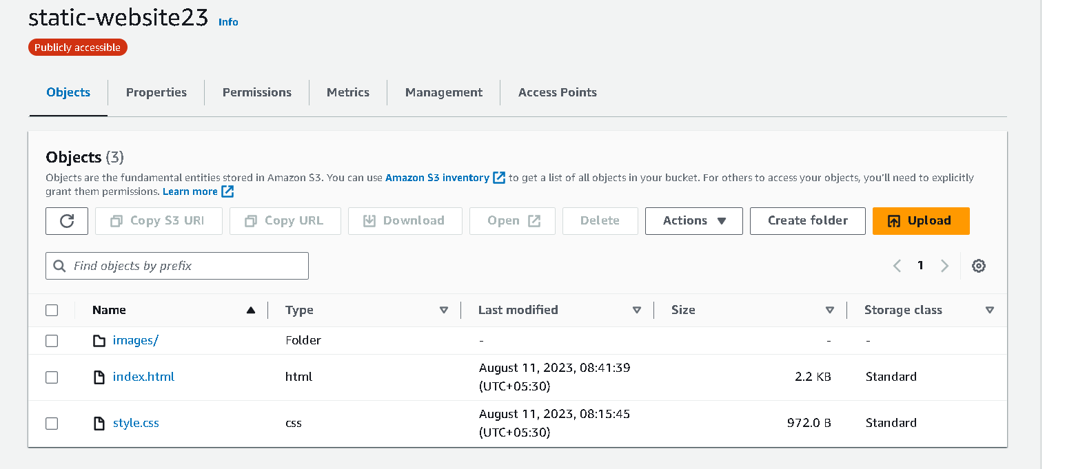
Step 2: Upload Your Website Files
Next, upload your website files to your S3 bucket. This includes your HTML, CSS, JavaScript, and any other assets your website needs. You can easily upload files using the AWS console or the AWS CLI.

Slide 13
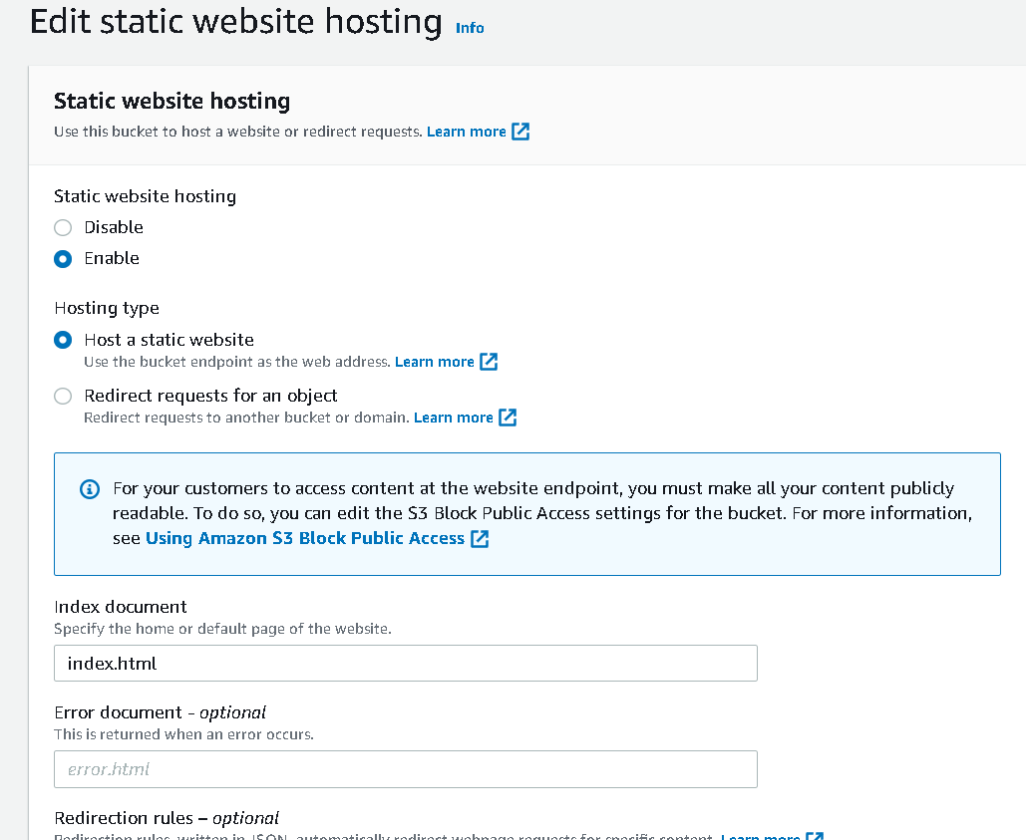
Step 3: Configure Your Bucket for Static Website Hosting
In order to host your website using your S3 bucket, you need to configure your bucket for static website hosting. This involves setting the default index and error documents, and optionally, adding a redirect.

Slide 14
Step 4: Create a CloudFront Distribution
To improve the performance of your website, you can create a CloudFront distribution. This will cache your website's files at edge locations around the world, reducing latency and improving load times.

Slide 15
Conclusion
Building a static website with AWS is a straightforward process that can save you time and money. By using S3 and CloudFront, you can easily create and host your website, while ensuring fast and reliable performance.

Slide 16
Thanks!
Do you have any questions?
Our Team Members
Vinay Kumar Swatambra Sahu
Shruti Duklan Soniya Pandey

